Slide 1
Inputs, Outputs, and Addons
CC Lab 2016 openFrameworks Week 4

Slide 2
openFrameworks is powerful because it handles various inputs & outputs.
Image source: http://www.testcurrentaffairs.com/2015/06/tips-for-solving-input-output-questions.html
Notes:
Your oF app is not limited to mouse/keyboard and computer screens. oF is good at grabbing and processing data from different sources, either off-line or in real-time, and outputting its computational outcome to various devices/places in various formats. This makes your oF applications/installations much more interesting than an on-screen sketch.
The versatility of oF is because:
It is based on C++, the universally used programming language—whenever a new I/O device is created, you can almost count on that it provides a C++-based API.
oF is designed to work with various I/Os. It has many I/O approaches integrated by default.
(be be continued in next page)

Slide 3
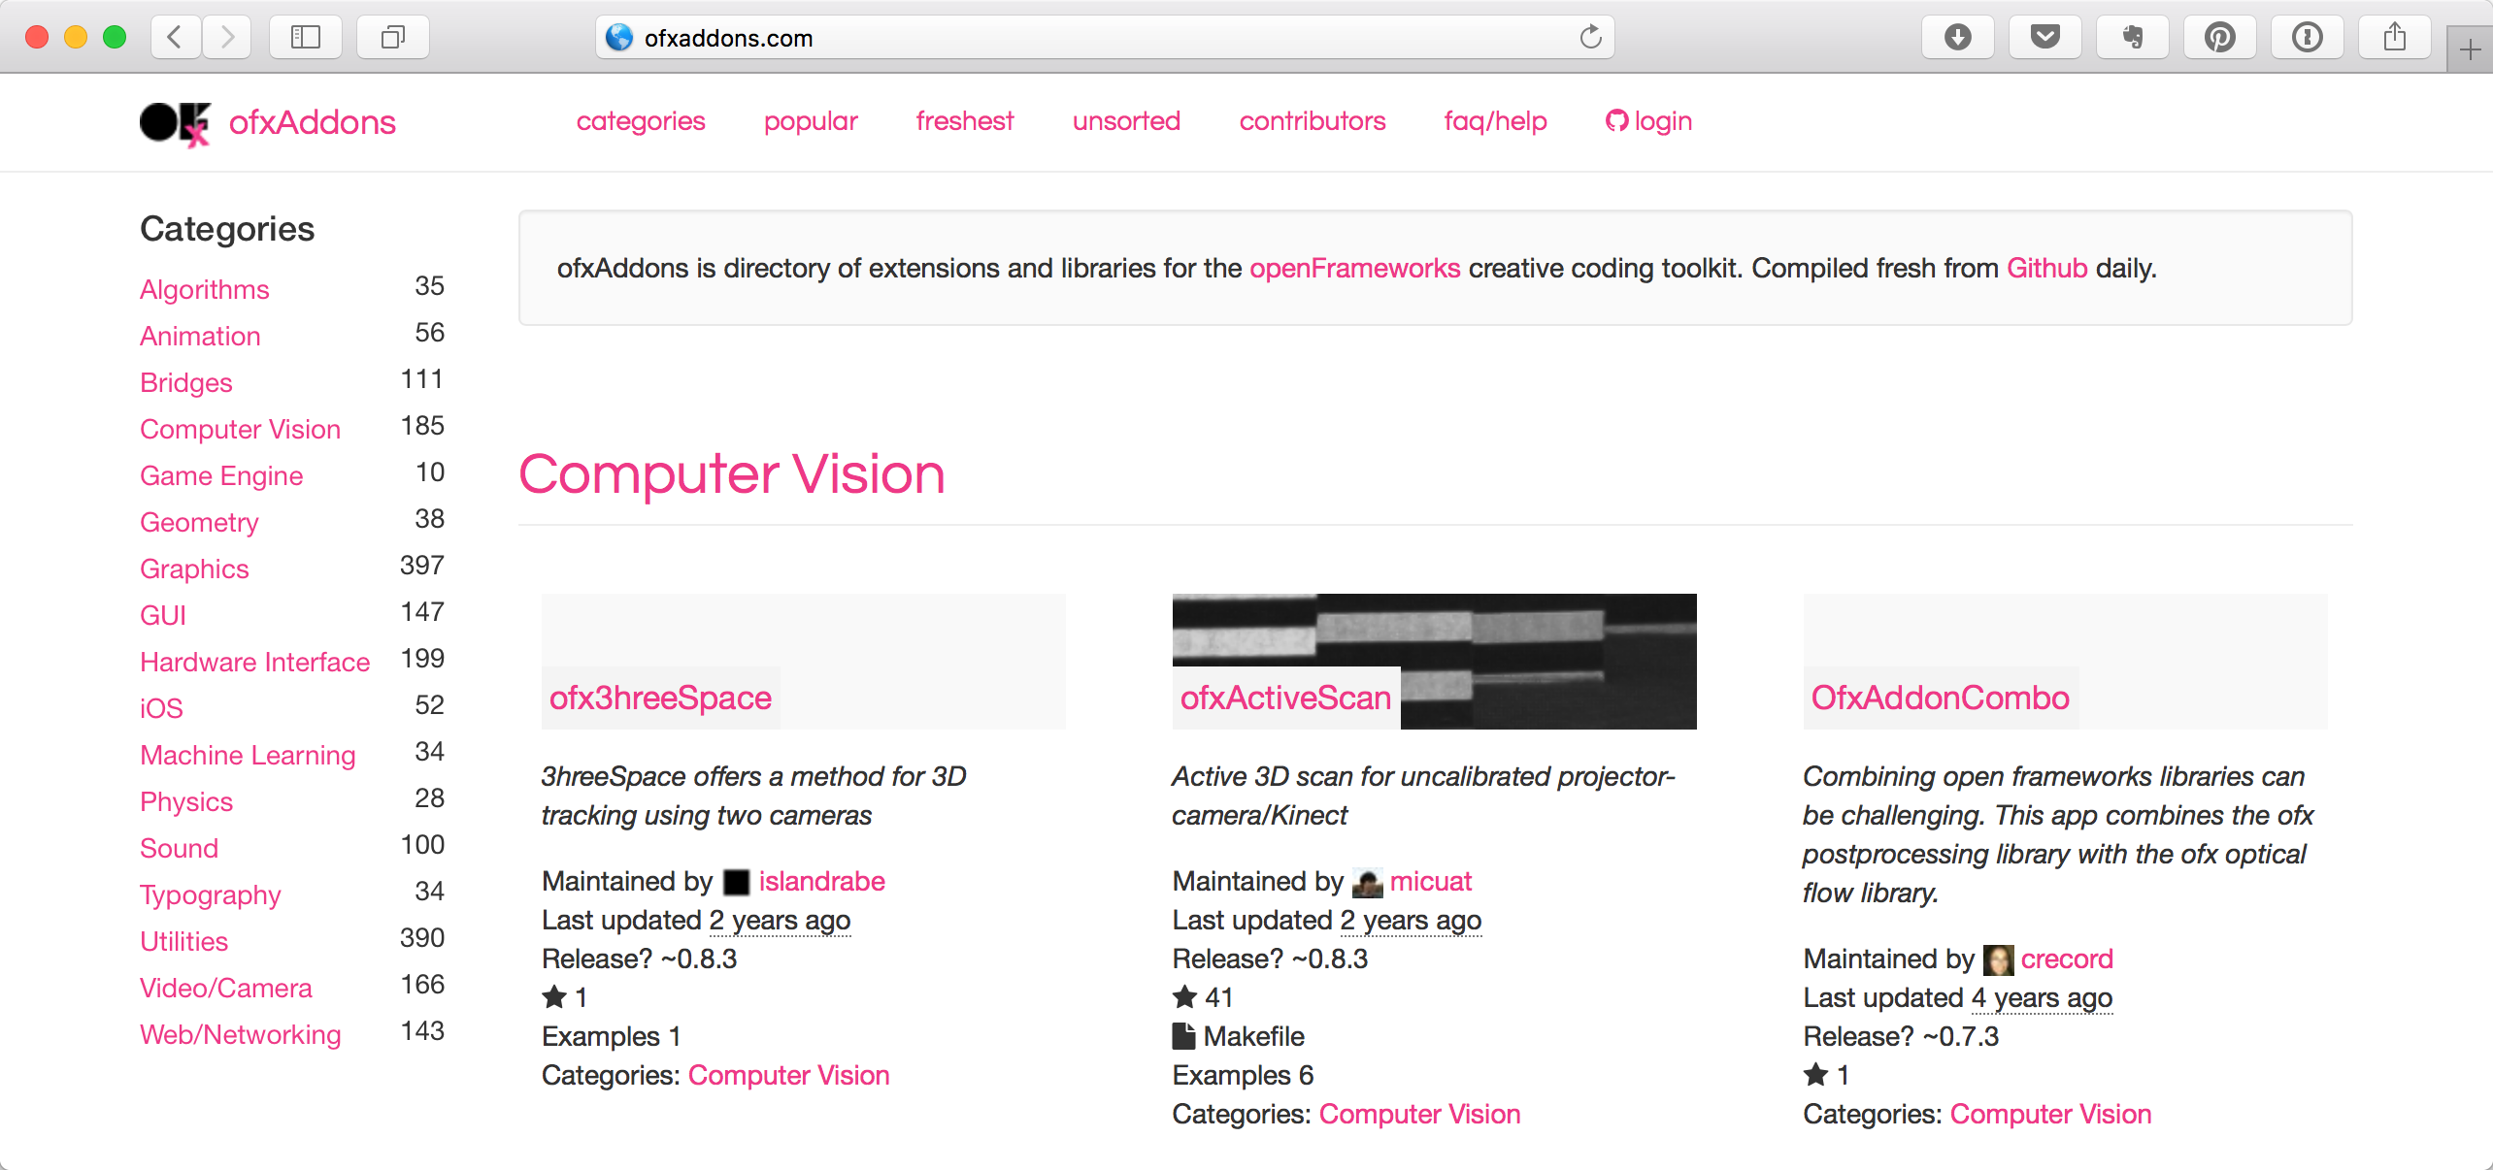
openFrameworks is even enhanced by addons!
Notes:
3. There are a lot of oF addons to support those I/O approaches not supported by oF by default.
Also, addons are a great resource when you want to implement functionalities. Many addons are actually wrappers of popular 3rd party libraries (for example, openCV for computer vision). Those 3rd party libraries have their own C++-based APIs, you can you them without using the oF addons. However, the addons provide the functionalities of the 3rd party libraries through the familiar oF-like APIs. Sweet.

Slide 4
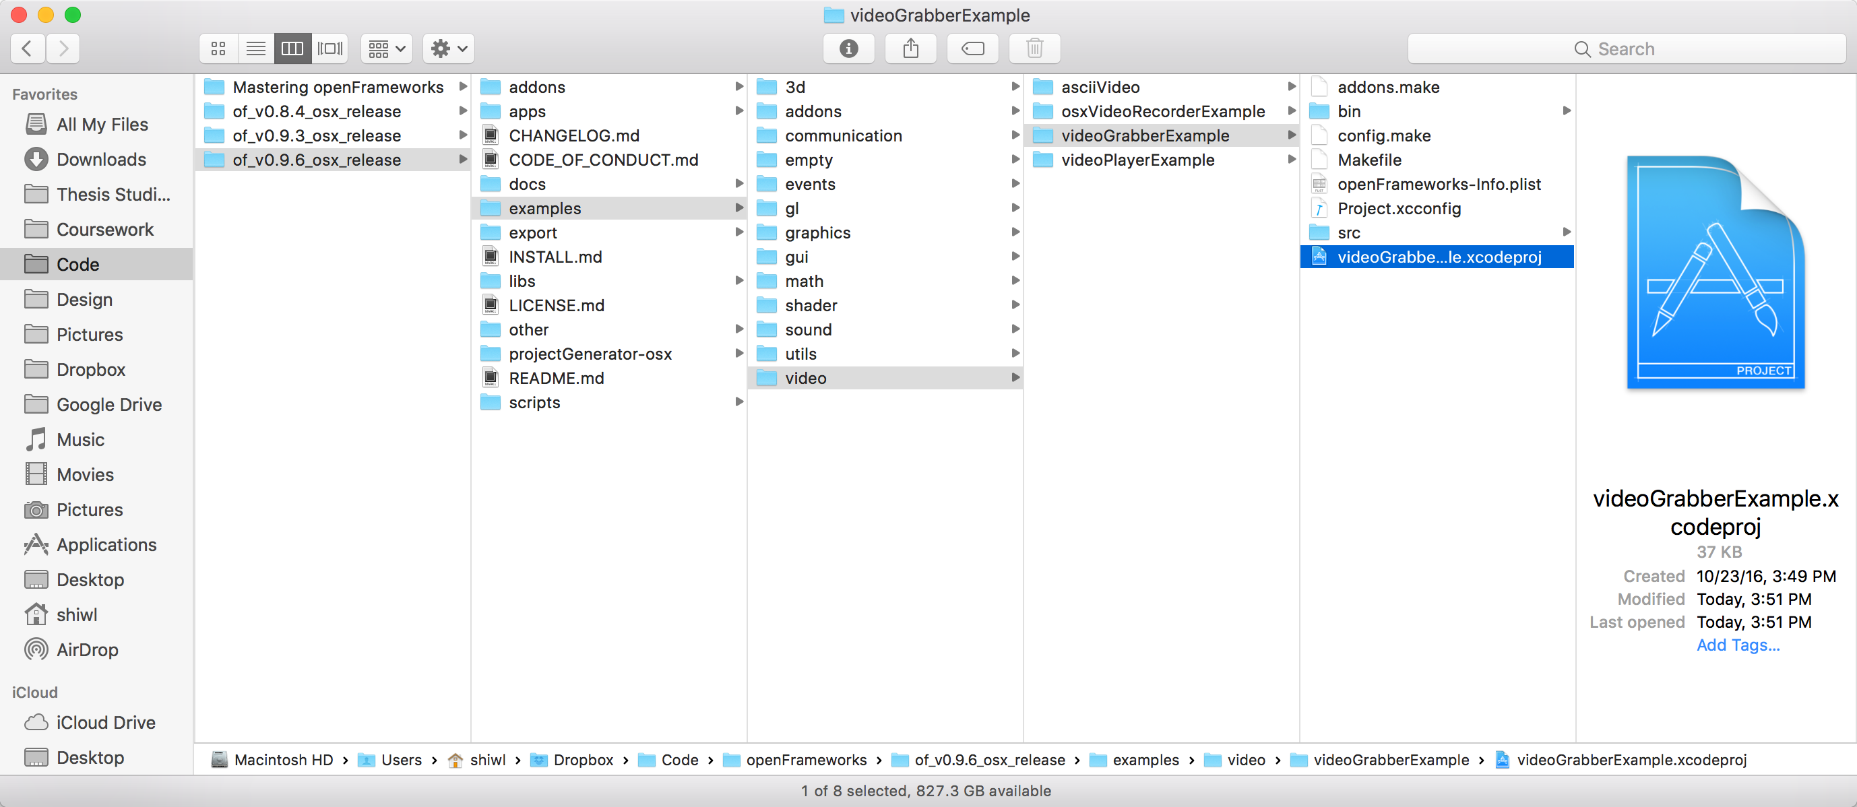
Input: Video Camera
examples/video/videoGrabberExample
Notes:
As we said, the best way to quickly learn an oF functionality is to look at the example code.
Open and build videoGrabberExample, you’ll see yourself together with a color-inverted version.

Slide 5
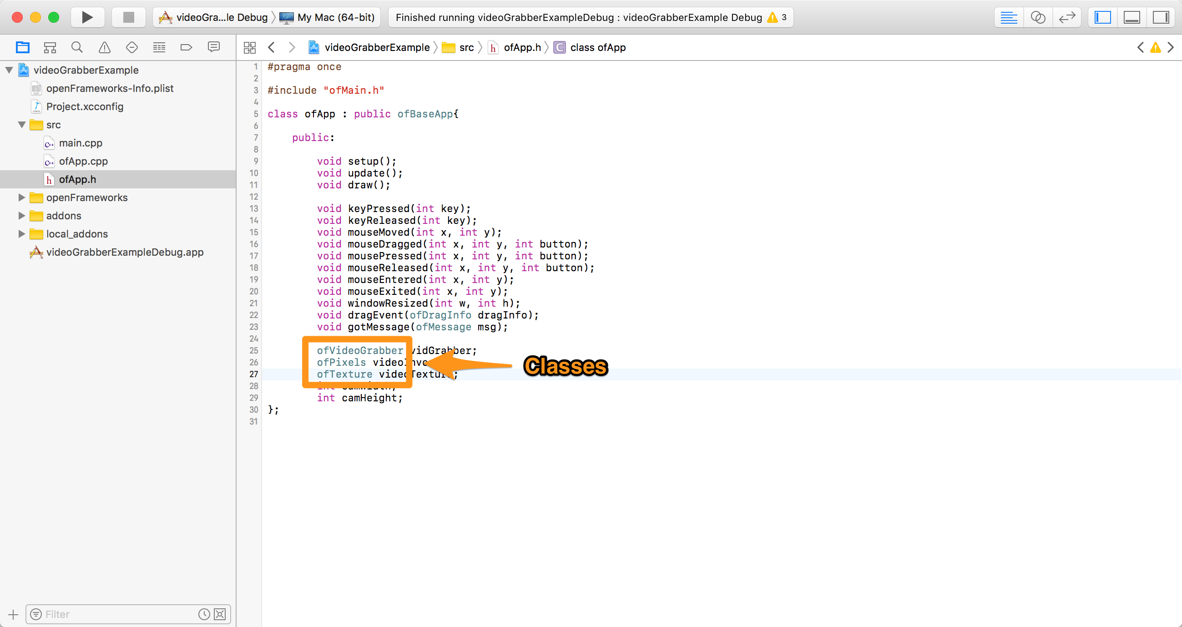
ofApp.h
Notes:
Now that we are familiar with OOP, we know that we are using objects of these classes.

Slide 6
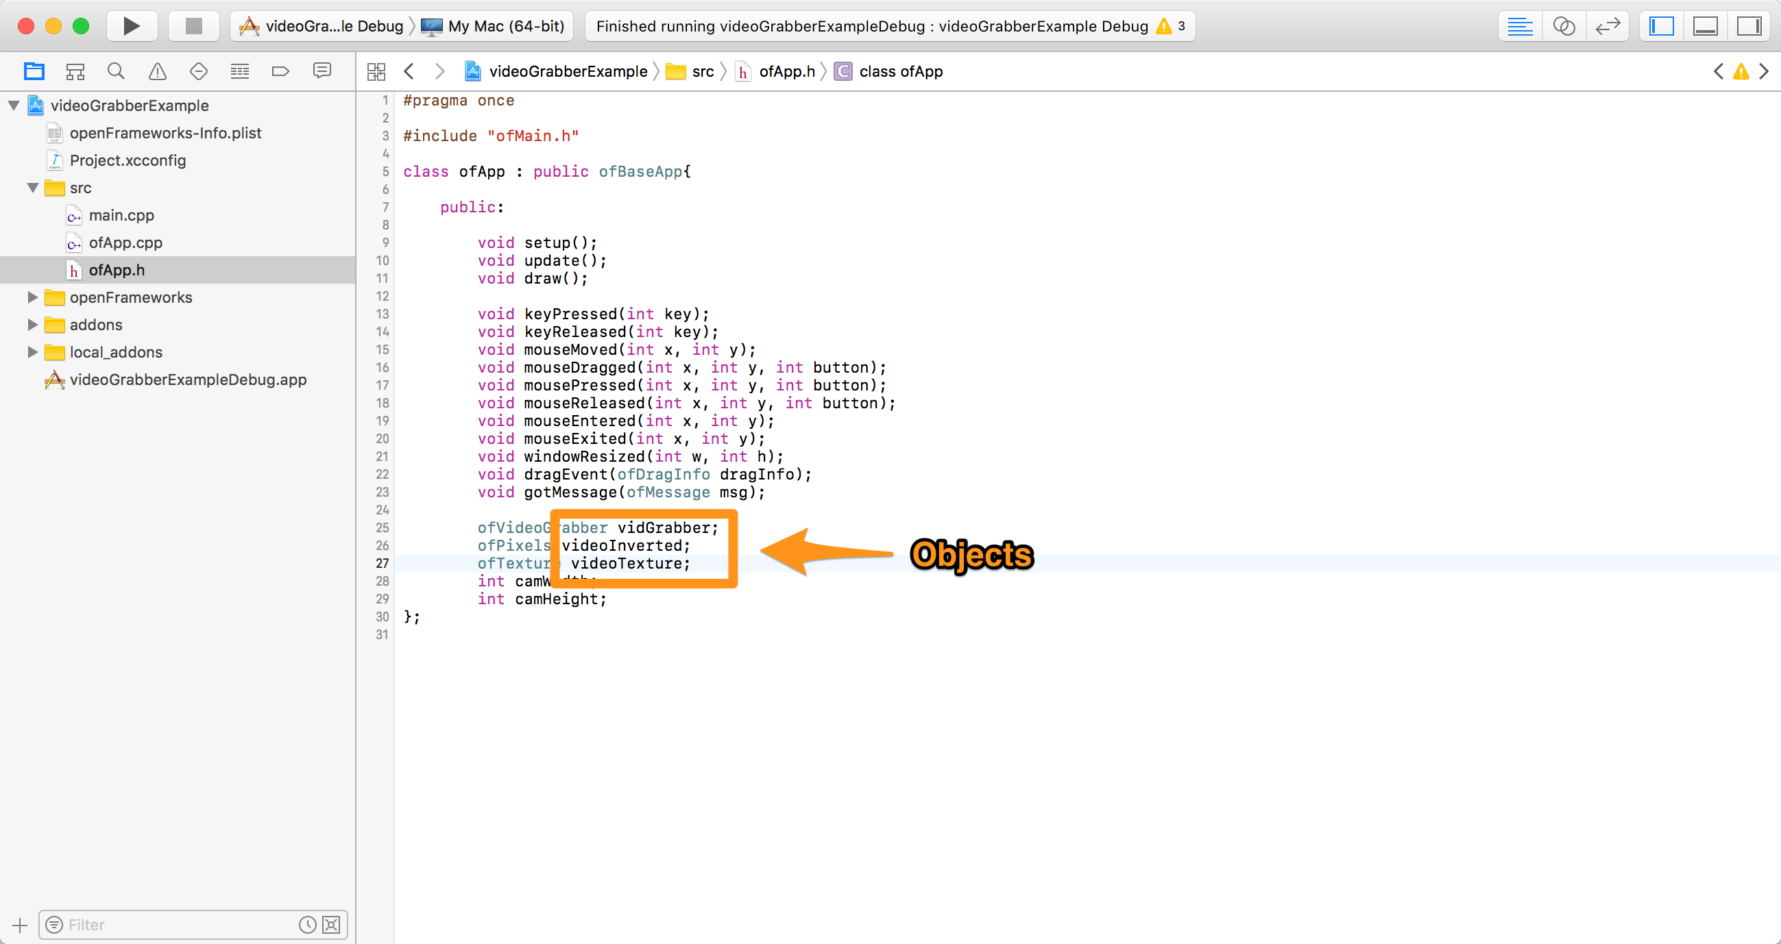
ofApp.h
Notes:
Three objects are used as data members of the ofApp class.

Slide 7
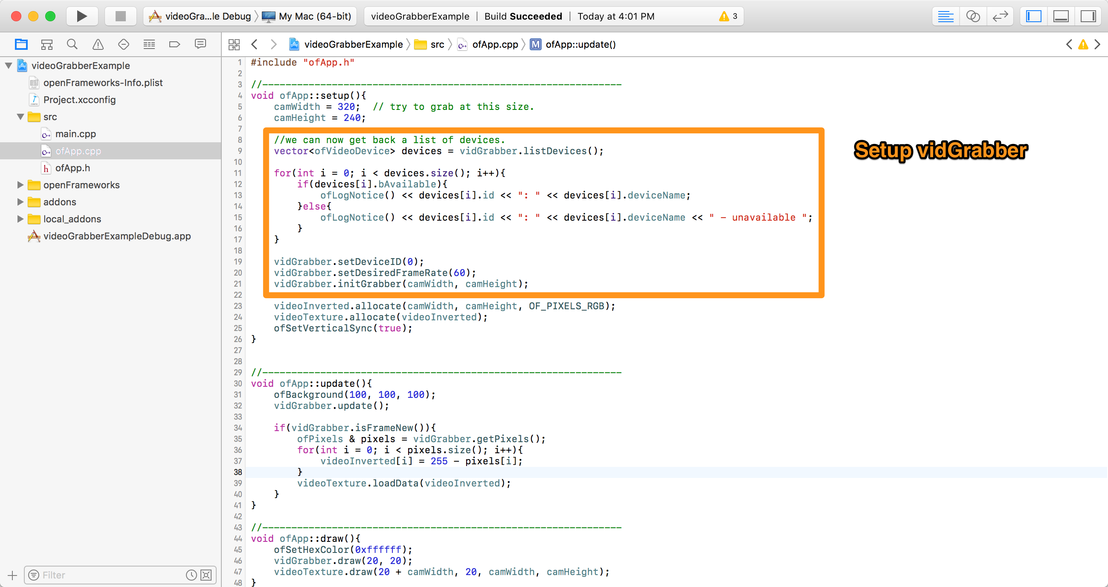
ofApp.cpp
Notes:
For devices, what we usually do is enumerating all existing devices, then select and setup one if available. Here they just selected the first one (index 0).

Slide 8
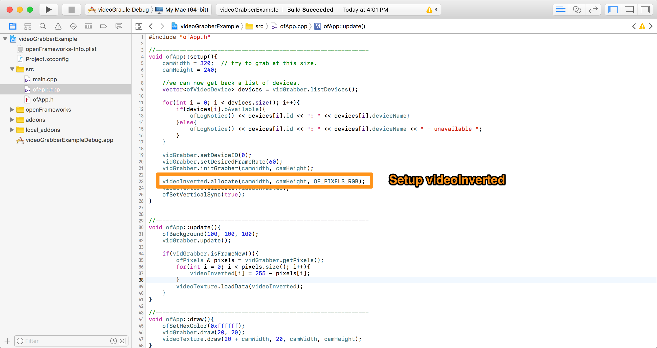
ofApp.cpp
Notes:
videoInverted is an object of ofPixels, which represents a block of memory. To setup it, you need to allocate a block of memory to the object.
Same thing for ofTexture, which is a block of memory on your graphics card.

Slide 9
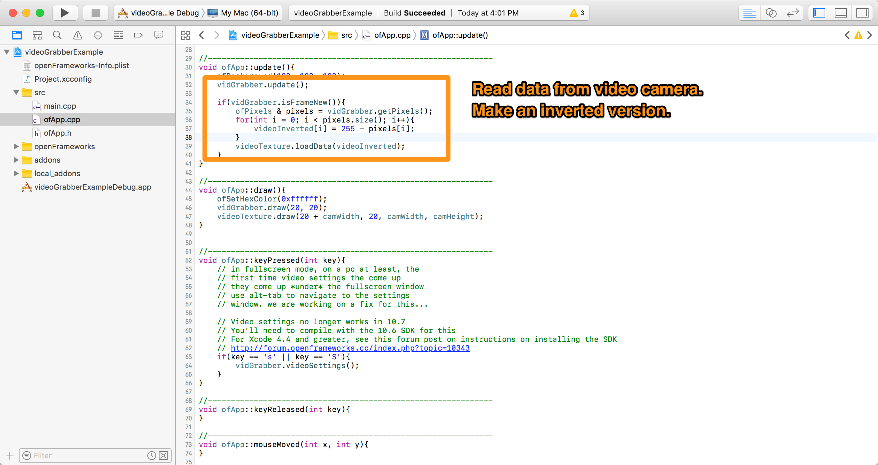
ofApp.cpp
Notes:
For every frame of your oF app, first update the data from video camera, then make an inverted version, and store it to videoTexture.

Slide 10
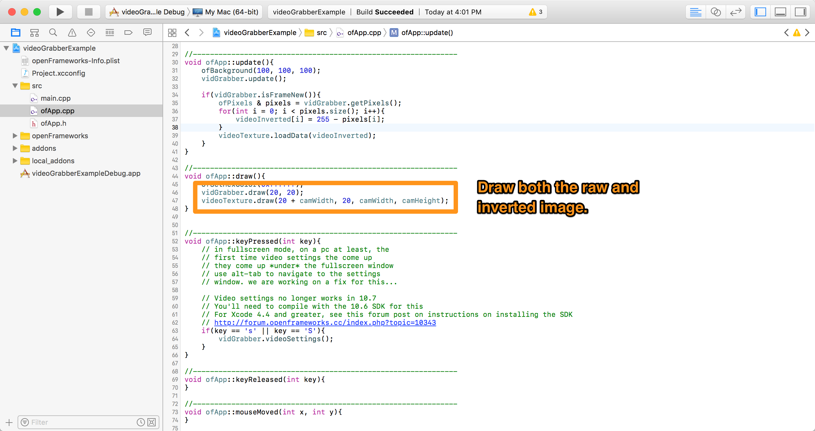
ofApp.cpp
Notes:
Finally, draw the raw and inverted image side by side.
Setup() once, then repeat update() and draw(). This is the routine of using many oF functionalities.

Slide 11
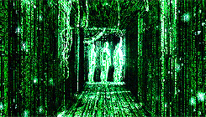
ofApp.cpp
Example: Computer Vision!
Notes:
Now that we know how to grab data from a webcam, let’s do some computation on the data!
We are going to use the ofxOpenCv addon to analy

Slide 12
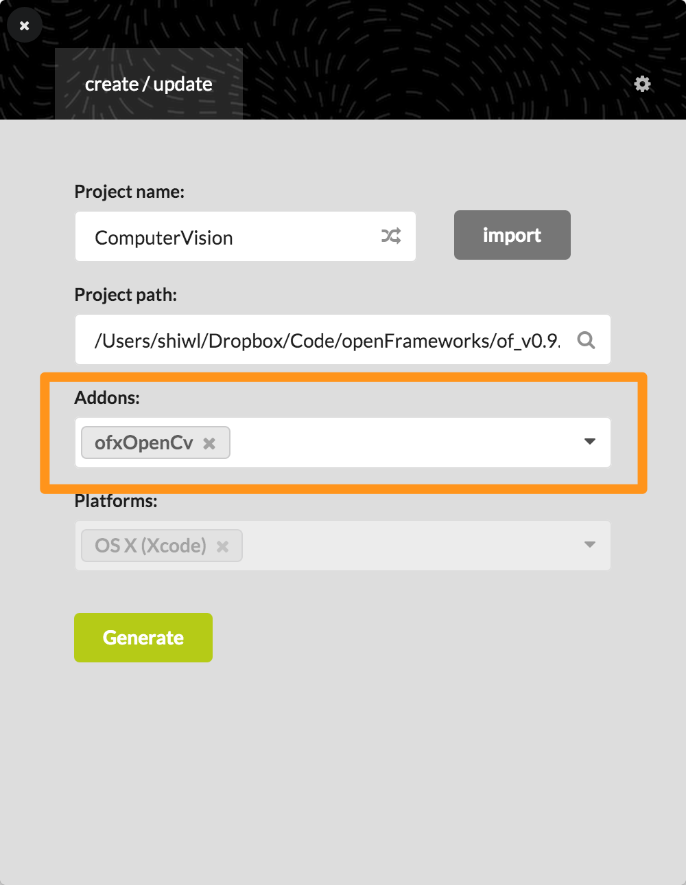
Add an addon to your oF project
Notes:
Remember to set the oF/project paths if ProjectGenerator is confused with them.
Add ofxOpenCv to your project.
(Then follow the example code.)

Slide 13
Look for cool addons from ofxaddons.com

Slide 14
Bonus Example: ofxKinect!
examples/addons/kinectExample
Notes:
(Demo the example to show depth sensing. If you don’t have a Kinect sensor, skip this example.)

Slide 15
1st Generation
(Kinect for Xbox 360)
Only buy model 1414!
2nd Generation
(Kinect for Xbox One)
Higher performance,
Harder to use！

Slide 16
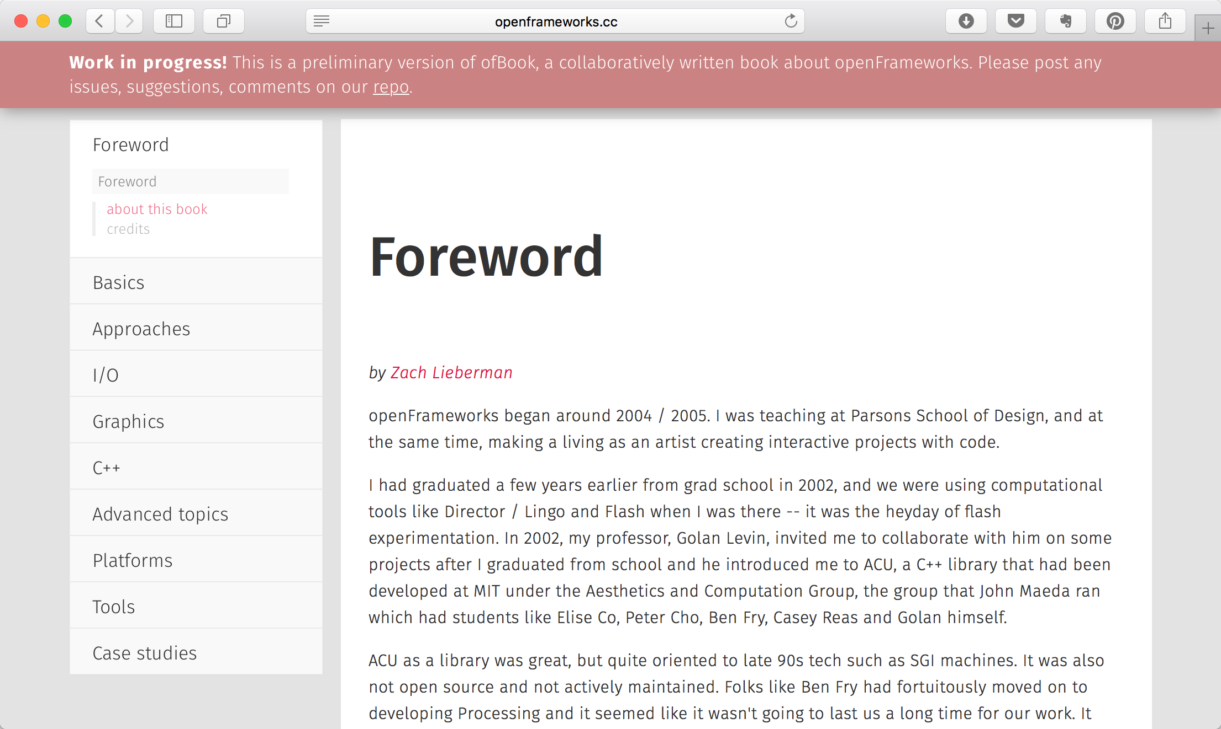
What’s next?
http://openframeworks.cc/ofBook/chapters/foreword.html
Notes:
Example projects are the fastest way to learn a new oF functionality.
Learn C++ systematically if you want to write sophisticated oF programs!

Slide 17
Homework
Choose (at least) one of the following:
Instead than display the detected blobs, use computer vision to do some interesting things.
Try to make your oF app talk with other programs (such as Max/MSP, Ableton Live, MadMapper, etc. Use ofxOSC or ofxSyphon to do these.)

